Slide 1

ANNAMACHARYA INSTITUTE OF TECHNOLOGY AND SCIENCES::TIRUPATI
(AUTONOMOUS)
Department of Artificial Intelligence
A.Y.: 2024-2025
FINAL REVIEW
A Novel Web Framework for Cervical Cancer Detection System A Machine Learning Breakthrough
Under the Guidance of
Mrs.Shaik.Shameen Taz.,M.Tech.,(Ph.D)
Associate Professor
Department of AI
AITS, Tirupati
Head of the Department
Dr. C.SivaBalaji Yadav., Ph.D
Professor
Department of AI
AITS, Tirupati
BATCH NO: 10
21AK1A3056 G PAVITHRA
21AK1A3055 A PAVITHRA
21AK1A3066 P RUCHITHA
22AK5A3012 B MAHESH

Slide 2
ABSTRACT
Cervical cancer remains a leading cause of cancer-related deaths among women worldwide, despite being preventable and treatable if detected early. Advances in machine learning (ML) have paved the way for innovative solutions to address the challenges of early diagnosis and timely intervention. This project introduces a novel web-based framework for cervical cancer detection that leverages cutting-edge ML algorithms to deliver accurate, efficient, and accessible diagnostic support. The proposed system integrates multi-dimensional data, including demographic information, medical histories, and screening test results, to train robust ML models for cervical cancer risk prediction. A user-friendly web interface allows healthcare providers and individuals to input patient data and receive real-time risk assessments, empowering informed decision-making. The framework utilizes advanced techniques such as ensemble learning, feature selection, and hyperparameter optimization to enhance predictive accuracy and reliability.
Keywords: Cervical, Cancer, Machine Learning, Dimensional Data

Slide 3
DOMAIN INTRODUCTION
Cervical cancer remains a significant public health challenge, ranking as one of the leading causes of cancer-related deaths among women worldwide.
Early and accurate detection is crucial for improving survival rates and reducing the global burden of this disease.
However, conventional diagnostic methods often face challenges such as high costs, limited accessibility, and reliance on expert interpretation, which may lead to delayed or inaccurate diagnoses.
In recent years, advancements in machine learning (ML) have revolutionized the field of medical diagnostics, offering unprecedented opportunities for enhanced accuracy, efficiency, and scalability.
Leveraging the power of ML, this study introduces a novel web framework designed specifically for cervical cancer detection.
This framework integrates state-of-the-art ML algorithms with an intuitive and user-friendly web interface, making it accessible to healthcare providers and researchers globally

Slide 4
RELATED WORKS (EXISTING)
Sl. | Title of the Paper | Problem Statement | Method / Algorithm Used | Year | Author Name
1. | Hybrid Machine Learning Approach for Cervical Cancer Detection Using Feature Selection | Irrelevant and redundant features in datasets can degrade the performance of classification models | Conventional diagnostic techniques, such as Pap smears, are often subjective, time-consuming, and prone to human error | 2020 | S. Patel M. Banerjee
2. | AI-Powered Mobile Application for Cervical Cancer Risk Assessment | There is a need for portable and accessible tools for cervical cancer risk assessment, particularly in low-resource settings | Logistic Regression with Principal Component Analysis | 2020 | J. David H. Kim S. Clark

Slide 5
RELATED WORKS (EXISTING) Continue…
Sl. | Title of the Paper | Problem Statement | Method/ Algorithm Used | Year | Author Name
3. | Automated Cervical Cancer Detection Using Transfer Learning on Pre-Trained Networks | Training models from scratch for medical image classification can be time-consuming and resource-intensive. | Transfer Learning with Pre-trained CNNs | 2021 | R. Ahmed L. Wang X. Zhao
4. | Deep Learning-Based Cervical Cancer Diagnosis: A Comprehensive Review | Conventional diagnostic techniques, such as Pap smears, are often subjective, time-consuming, and prone to human error | Conventional diagnostic techniques, such as Pap smears, are often subjective, time-consuming, and prone to human error | 2021 | A. Gupta P. Sharma R. Kumar
5. | Web-Based Cervical Cancer Prediction System Using Ensemble Learning Techniques | Existing diagnostic tools are often inaccessible to resource-constrained regions, and standalone applications lack scalability and remote usability | Random Forest | 2022 | K. Lee T. Nguyen A. Smith

Slide 6
PROPOSED SYSTEM
The proposed system introduces a web-based framework for cervical cancer detection, leveraging advanced machine learning algorithms and a user-friendly interface.
This system is designed to overcome the limitations of existing diagnostic methods, such as delays in diagnosis, limited accessibility, and high reliance on expert interpretation.
At its core, the system begins with data acquisition, supporting diverse input types such as cervical cytology images, clinical records, and demographic information.
The machine learning engine drives the system’s analytical capabilities, utilizing state-of-the-art algorithms tailored for specific tasks.
The framework includes a web-based interface that provides healthcare professionals with a seamless experience for data entry, result visualization.
The proposed system reduces manual intervention and human error. Its web-based architecture makes it accessible in remote or resource-constrained areas, while its multi-algorithm approach ensures high diagnostic accuracy.
This framework is poised to transform cervical cancer diagnostics by enabling early detection, facilitating remote healthcare delivery, and supporting large-scale research initiatives.

Slide 7
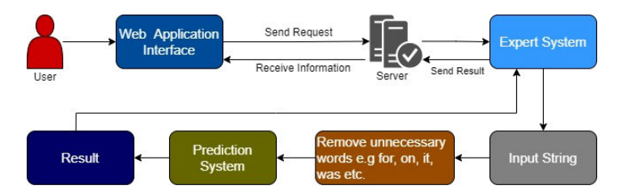
System Architecture

Slide 8
MINIMUM SYSTEM REQUIREMENTS
Software Requirements:
Application platform : Python 2.0 & above
Operating System : Windows 7
IDE : Pycharm
Framework : Django
Hardware Requirements:
RAM : 2GB & above
Processor : Intel I3 & Above

Slide 9
ANALYSIS AND DESIGN

Slide 10
Analysis
System and User Modules
1. Service Provider:
In this module, the functionalities are follows :
Login
Train and Test Data sets
View Data set Trained and Tested Accuracy in Bar chart
View Trained and Tested Accuracy Results
View Cervical Cancer type
Download Prediction data set
View Cervical Cancer Type ratio
View Cervical Cancer Type ratio results
View All Remote Users
Logout

Slide 11
2. Remote User:
In this module, the functionalities are follows :
Register
Login
Predict Cervical Cancer Type
View profile
Logout

Slide 12
3. Dataset Loading Module:
Facilities the loading of datasets for training and evaluation process
Provides graphical representation
4. Training and Evaluation Module
Training the Model
Evaluate the model with Precision and Recall
5. User Interface Module
Provides a user friendly interface for users to interact with system
Display functionalities like signup, login, prediction and training and accuracy results

Slide 13
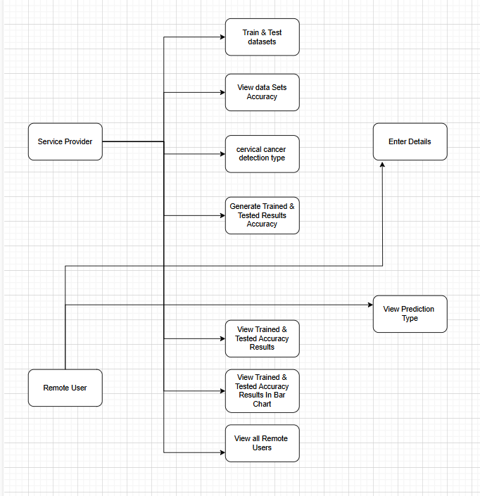
DESIGN
Data Flow Diagram

Slide 14
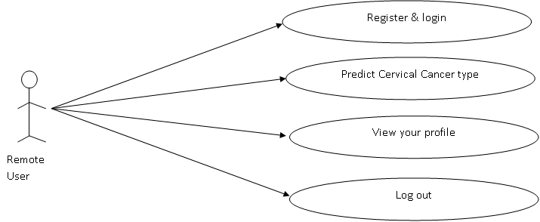
UML DIAGRAMS
USE CASE DIAGRAM FOR REMOTE USER

Slide 15
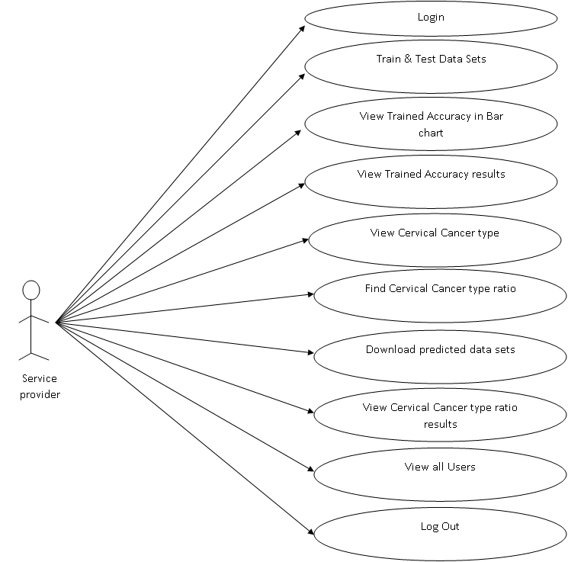
USE CASE DIAGRAM FOR SERVICE PROVIDER

Slide 16
SEQUENCE DIAGRAM
Service Provider
Server
Remote User
LOGIN
Register & Login
1. Train & Test data sets
2. view Trained Accuracy in Bar Chart
3. View Trained Accuracy results
4. View cervical cancer Type
5. Find cervical cancer Type ratio
6. Download Predicted data sets
7. View cervical cancer Type ratio results
8. View all Users
9. Predict cervical cancer detection Tpye
10. View your Profile

Slide 17
CLASS DIAGRAM
Service Provider
+ User Name + Password
+ Login() + Train and Test datasets() + View Trained Accuracy in Bar chart() + View Trained Accuracy Results() + View cervical cancer detection Type() + View cervical cancer detection Type ratio() + Download predicted data sets() + View cervical cancer type ratio results() + View all users() + Log out()
Remote User
+ User Name + Phone Number + Email + Password
+ Register & Login() + Predict cervical cancer type() + View your profile() + Log out()

Slide 18
COLLABORATION DIAGRAM
Remote User
Service Provider
1. Login
2. Train and Test Data sets
3. View Data set Trained and Tested Accuracy in Bar chart
4.View Trained and Tested Accuracy Results
5.View Cervical Cancer type
6.Download Prediction data set
7.View Cervical Cancer Type ratio
8.View Cervical Cancer Type ratio results
9.View All Remote Users
10. Log Out
1. Register & Login
2. Predict Cervical Cancer Type
3.View profile
4. Log Out
Server

Slide 19
ACTIVITY DIAGRAM
Activity Diagram for Remote User
Register & Login
Check
Invalid
Valid
Predicted cervical cancer detection Type
View your users
Log Out

Slide 20
Activity Diagram for Service Provider
Login
Check
Invalid
Valid
Train & Test Datasets
Download predicted datasets
View trained Accuracy in Bar Chart
View cervical cancer detection type ratio results
View trained Accuracy Results
View all users
View cervical cancer detection type
Log out
Find cervical cancer detection type ratio

Slide 21
DEPLOYMENT DIAGRAM
Service
Provider
Remote User
Server

Slide 22
IMPLEMENTATION
import tensorflow as tf
from keras.applications import Xception
from keras.layers import Dense, GlobalAveragePooling2D, Dropout, BatchNormalization,Flatten
from keras.models import Model
from keras.optimizers import RMSprop
from keras.callbacks import ReduceLROnPlateau, EarlyStopping
import tensorflow as tf
import os
from tensorflow.keras.preprocessing.image import ImageDataGenerator
from tensorflow.keras import layers, models
import matplotlib.pyplot as plt
import numpy as np
from sklearn.model_selection import train_test_split
from tensorflow import keras
from sklearn import preprocessing
from keras.utils import to_categorical

Slide 23
IMPLEMENTATION
# Set your data directories and parameters
train_data_dir = r'D:\new project\New folder (7)\NEW_DATASET\train'
test_data_dir = r'D:\new project\New folder (7)\NEW_DATASET\test'
val_data_dir = r'D:\new project\New folder (7)\NEW_DATASET\validation'
:
# Data augmentation for training
train_datagen = ImageDataGenerator(
rescale=1.0/255,
rotation_range=45,
width_shift_range=0.2,
height_shift_range=0.2,
horizontal_flip=True,
vertical_flip=True,
zoom_range=0.2,
fill_mode='nearest'
)
)

Slide 24
IMPLEMENTATION
import matplotlib.pyplot as plt
import seaborn as sns
import numpy as np
import pandas as pd
# Make Predictions
y_pred = final.predict(test_generator)
# Convert Predictions and True Labels
y_pred_classes = np.argmax(y_pred, axis=1)
y_true_classes = test_generator.classes
# Create the Confusion Matrix
cm = confusion_matrix(y_true_classes, y_pred_classes)
# Create a dictionary to map class indices to class names
class_indices = test_generator.class_indices
class_names = {v: k for k, v in class_indices.items()}
# Calculate precision, recall, and F1 score for each class
precision = precision_score(y_true_classes, y_pred_classes, average=None)
recall = recall_score(y_true_classes, y_pred_classes, average=None)
f1 = f1_score(y_true_classes, y_pred_classes, average=None)

Slide 25
IMPLEMENTATION
# Visualize the Confusion Matrix
plt.figure(figsize=(10, 8))
sns.heatmap(cm, annot=True, fmt='d', cmap='Blues',
xticklabels=test_generator.class_indices,
yticklabels=test_generator.class_indices)
plt.xlabel('Predicted')
plt.ylabel('True')
plt.title('Confusion Matrix')
plt.show()

Slide 26
TESTING
The Testing phase plays a crucial role in ensuring the reliability and effectiveness of the system. The Testing approach encompasses various key aspects aimed at validating the system's performance, security, and functionality.
Testing Objectives:
Verify the uniqueness and immutability of product identifiers generated using the system.
Testing various data type while inputting the data.
Test the system's ability to detect and reject counterfeit products.
Assess the performance of the system under various load conditions.

Slide 27
TESTING
To ensure the system's effectiveness and reliability, we have conducted comprehensive testing across various aspects, as detailed below:
Data Accuracy and Completeness:
Test various data types (text, numbers, images) for accuracy.
Verify data consistency across different access points (e.g., manufacturer, consumer).
Check for missing or incomplete information that could impact trust.
User Experience (UX):
Test on diverse devices with different operating systems and screen sizes.
Evaluate scanning speed and success rate under various lighting conditions.
Assess clarity and intuitiveness of the verification process and information display.
Performance and Scalability:
Measure response times and resource utilization under load.
Evaluate system's ability to scale horizontally or vertically to meet demand.

Slide 28
TESTING
Functional Testing:
Functional testing focuses on verifying that each component of the system performs its intended functions accurately.
Security Testing:
Security testing is essential to identify and mitigate potential vulnerabilities within the system that could compromise product authenticity and consumer trust. This involves conducting penetration testing and vulnerability assessments to detect and address any security loopholes. Security testing ensures that the system is robust and resistant to unauthorized access or tampering.

Slide 29
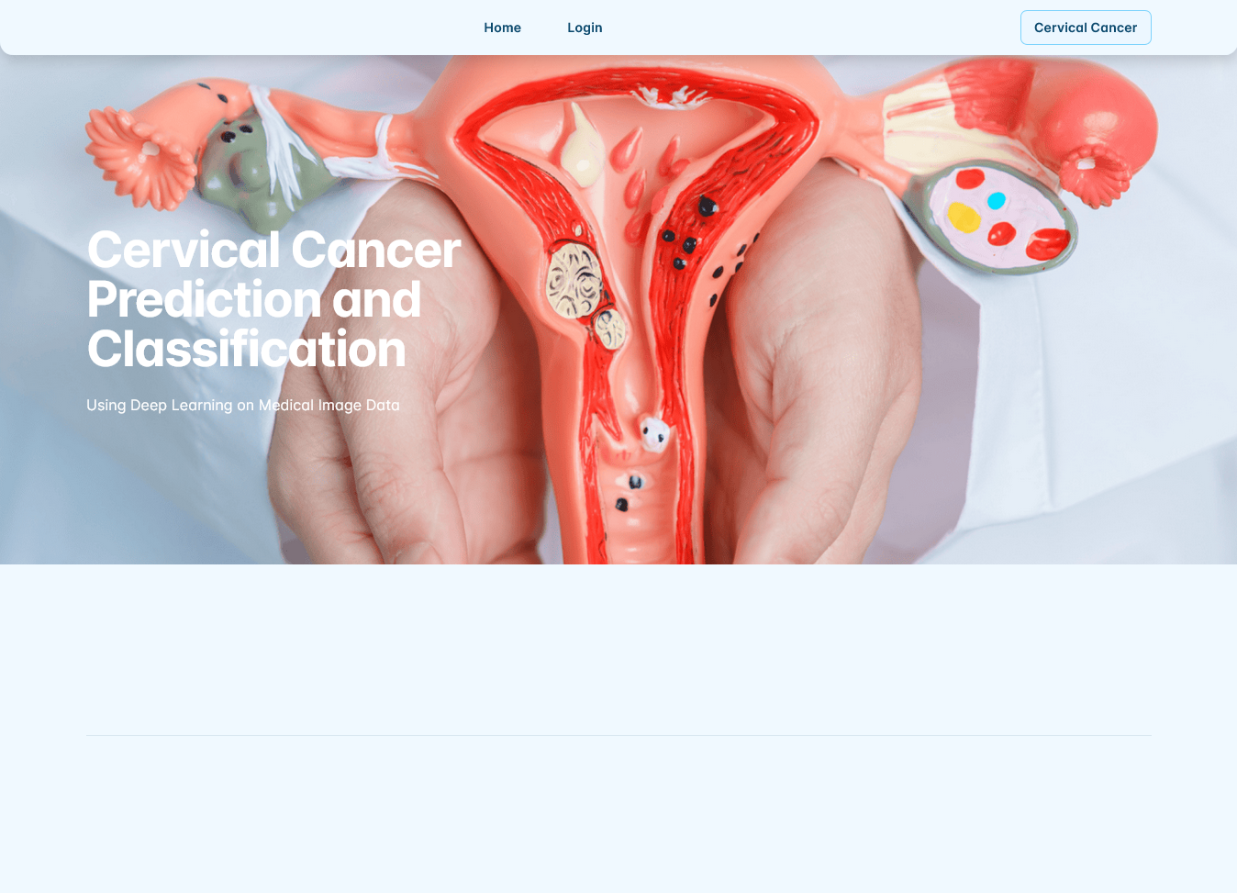
RESULTS

Slide 30
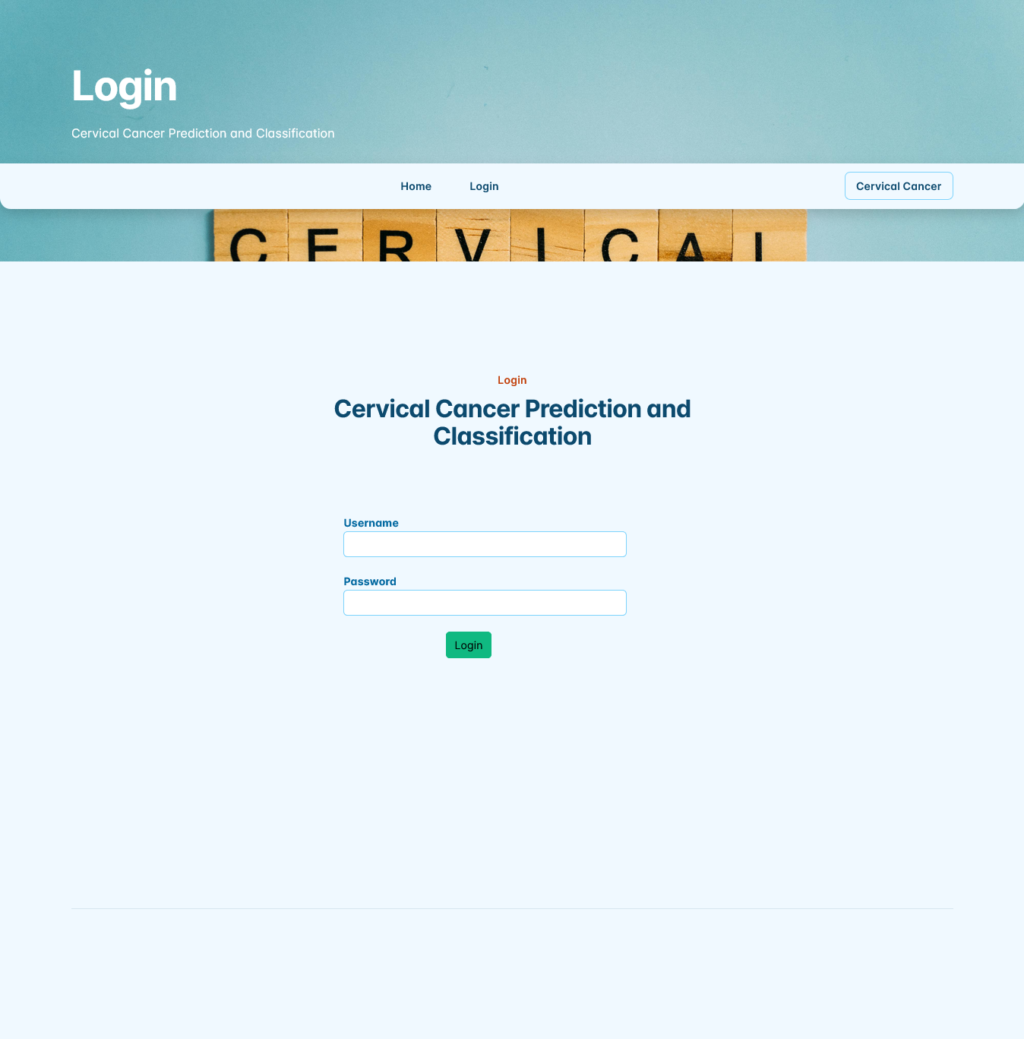
RESULTS

Slide 31
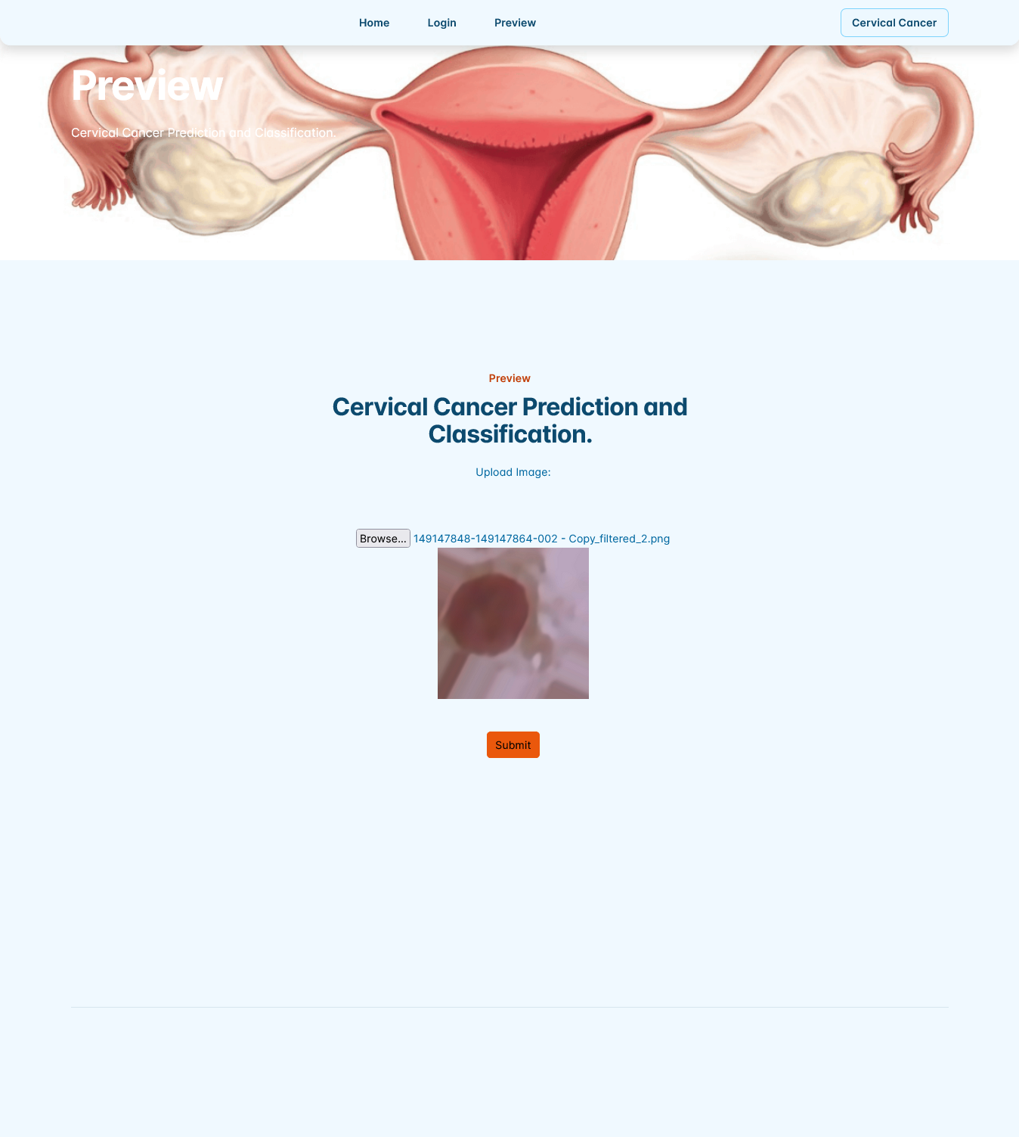
RESULTS

Slide 32
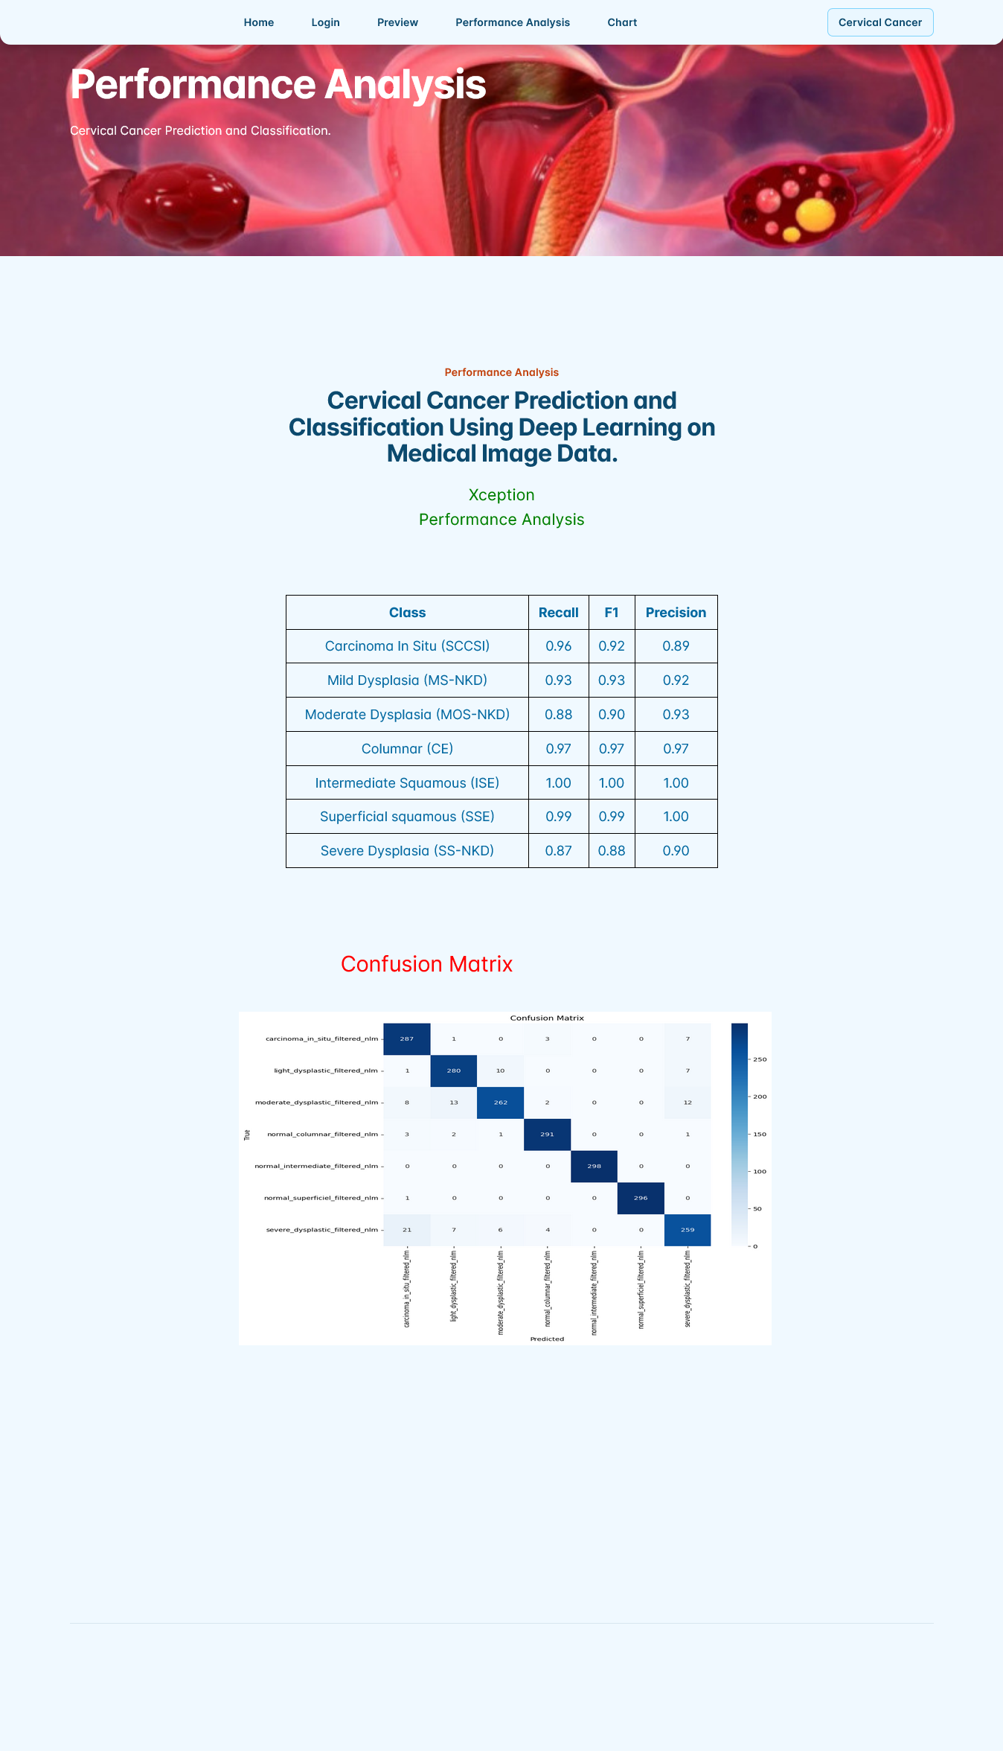
RESULTS

Slide 33
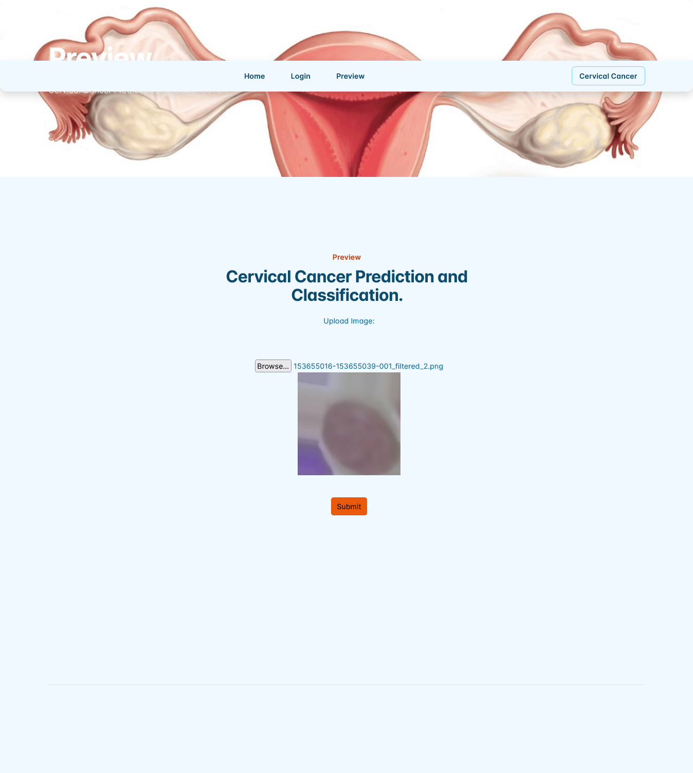
RESULTS

Slide 34
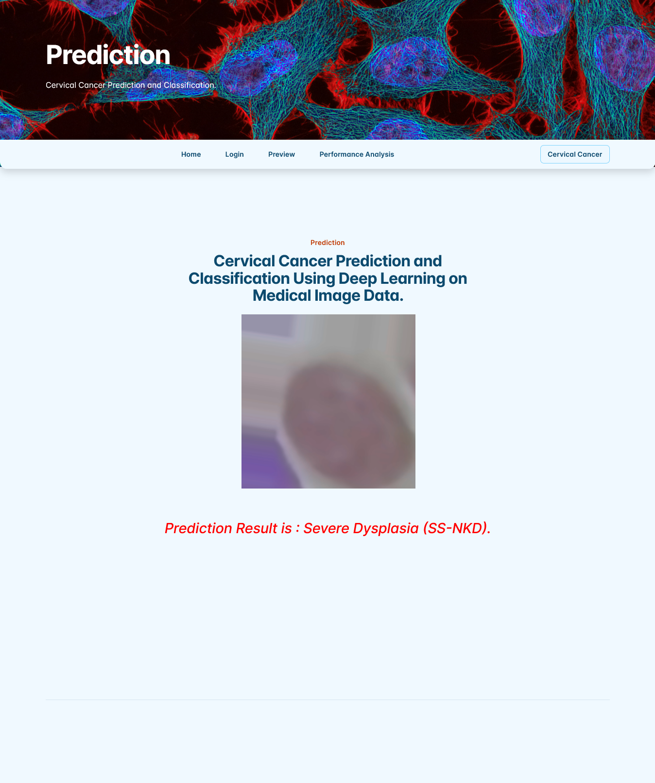
RESULTS

Slide 35
Conclusion
In conclusion, the novel web framework for cervical cancer detection powered by machine learning represents a significant breakthrough in early diagnosis and healthcare accessibility. By integrating advanced machine learning algorithms with a user-friendly web interface, this system enhances the accuracy and efficiency of cervical cancer detection, reducing the dependency on traditional, time-consuming diagnostic methods. The framework’s ability to process and analyze medical data swiftly enables timely interventions, ultimately improving patient outcomes. Additionally, its web-based nature ensures wider accessibility, allowing healthcare professionals and patients from remote or underserved areas to benefit from advanced diagnostic tools. The incorporation of automation minimizes human error, making the detection process more reliable. As technology continues to evolve, this system can be further optimized with deep learning advancements and integration with electronic health records for seamless medical assessments

Slide 36
REFERENCES
A. Gupta, P. Sharma, and R. Kumar, “Deep learning-based cervical cancer diagnosis: A comprehensive review,” Journal of Medical Imaging and Health Informatics, vol. 11, no. 2, pp. 45–60, 2021.
S. Patel and M. Banerjee, “Hybrid machine learning approach for cervical cancer detection using feature selection,” International Journal of Data Science and Analytics, vol. 9, no. 3, pp. 150–162, 2020.
K. Lee, T. Nguyen, and A. Smith, “Web-based cervical cancer prediction system using ensemble learning techniques,” in Proceedings of the ACM Symposium on Health Informatics, pp. 123–134, 2022.
R. Ahmed, L. Wang, and X. Zhao, “Automated cervical cancer detection using transfer learning on pre-trained networks,” IEEE Access, vol. 9, pp. 11234–11247, 2021.
J. David, H. Kim, and S. Clark, “AI-powered mobile application for cervical cancer risk assessment,” Mobile Health Technology Journal, vol. 7, no. 4, pp. 321–334, 2020.

Slide 37
Any Queries?

Slide 38
Thanking You

